Slide 1
Switch Statements

Slide 2
Switch Statements
Consider a simple user menu for a store simulation program.
There should be options to buy certain items, check your total money spent, cancel items selected, exit, and finish and pay.

Slide 3
Switch Statements
We could take the input from this menu and do a complicated, nested series of if-else statements, but that would quickly become bulky and difficult to read.

Slide 4
Switch Statements
However, there is an easy way to handle such data input with a switch statement.
Depending on which command is chosen, the program will select one direction out of many.

Slide 5
Switch Statement set up
switch (expression){
case value1:
statement1;
statement2;
...
break;
case value2:
statement3;
statement4;
...
break;
case valuen: //any number of case statement may be used
statement;
statement;
break;
default:
statement;
statement;
break;
} /* end of switch statement */

Slide 6
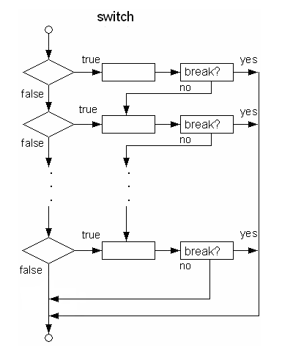

Slide 7
Common Error
Forgetting to include the break statements to terminate each case value, causing all the statements following the matching case value are executed.
The switch statement cannot compare double values.

Slide 8
switch (day){
case 3:
System.out.println ("Wednesday");
break;
case 4:
System.out.println ("Thursday");
break;
case 5:
System.out.println ("Friday");
break;
default:
System.out.println ("not a valid day");
break;
}
We pass in the integer day

